Slide 1
Data Science and Related Terms: Overview of the landscape
Terms used:
Data science
Machine Learning
Artificial Intelligence
Big Data
Data Mining
Statistics

Slide 2

Overview of the landscape
Terms used:
Data science
Machine Learning
Artificial Intelligence
Big Data
Data Mining
Statistics
@jeremyjarvis
“A data scientist is a statistician who lives in San Francisco”
@BigDataBorat
Data science is statistics on a Mac.
@josh_wills
Data Scientist (n.): Person who is better at statistics than any software engineer and better at software engineering than any statistician
(anonymous)
The difference between statistics and data science is about 30k per year.
(anonymous)
It is statistics if it’s done in R.
Its Machine learning if it’s done in Python
Its AI if it’s done in Powerpoint.

Slide 3
Overview of the landscape
Statistics: The very first line of the American Statistical Association’s definition of statistics is “Statistics is the science of learning from data...” Given that the words “data” and “science” appear in the definition, one might assume that data science is just a rebranding of statistics.
Statisticians are not happy they are not getting the research funding and salary bumps involved.
Data science: Broad and modern term. Includes much more software engineering knowledge. Usually done in Python (as opposed to R/Stata/SAS/SPSS/Excel etc). Includes analytics on bigger datasets (e.g. terabytes or petabytes by using tools like Apache Spark, Hadoop Mapreduce which enable distributed processing. Includes data collection and data cleaning pipelines (data engineering/ data wrangling). Connections to database backends and web-serving front-ends. Includes to some extend machine learning and AI as sub-areas.
Machine learning: The more mathematically complex part of data science focused on modeling (as opposed to software). Includes supervised learning, predictive modeling, unsupervised learning (like clustering), text and image understanding.
Artificial Intelligence: Broad and classic term that includes machine learning as a sub-discipline. Allowing computers to do things that humans do when they say they are thinking. Includes perception (image understanding, speech understanding), Language translation, playing games, statistical machine learning techniques but also logic-based symbolic AI, reasoning, planning, and robotics).
Data Mining: Applied version of Machine learning. Includes more large-scale software and performance issues. Also intersects the database community.
Big Data: Focused on scaling data analytics to very large data sets. Part of data science that will hopefully follow the information superhighway and internet surfing to obsolete historical nomenclature.

Slide 4
In terms of research communities:
Statistics
Research published in stats journals. Top venues: Annals of Statistics, JASA, Journal of the Royal Statistical Society.
Data science:
Not a properly defined research community.
Machine learning:
Research published in top ML conferences: NeurIPS, ICML, also more recently ICLR. Also includes KDD (more applied, data mining).
https://iclr.cc/virtual_2020/index.html
Artificial Intelligence:
Includes ML conferences but also AAAI and IJCAI as top venues.
Data Mining: Applied version of Machine learning. Includes more large-scale software and performance issues. Also intersects the database community.
Research published in top Data Mining conferences: KDD, SDM.
Big Data:
Not a properly defined research community.
Engineers who can setup Hadoop/Spark clusters. Can work on data directly on disk and process at massive scale.

Slide 5
A taxonomy for machine learning
We will develop a taxonomy of different machine learning problems.
1. Supervised versus Unsupervised.

Slide 6
Supervised learning: Binary classification
Given a table of training data containing features (x1,x2,..) and a target variable y we want to predict.
Example: Taste-test: Predict if a new beverage will be evaluated as having ‘Great taste’ from a focus group.
 | Acidity(A) | Sweetness (S) | y=‘Great taste’?
Bev1 | 0.8 | 0.8 | 1
Bev2 | 0.3 | 0.25 | 0
Bev3 | 0.2 | 0.8 | 0
Bev4 | 0.3 | 0.7 | 0
Bev5 | 0.9 | 0.7 | 1

Slide 7
Supervised learning: Binary classification Data-driven Taste Test example
Jargon: Every row is called a training set sample.
We have 2 features (Acidity and Sweetness). In practice we may have many more (Color, Carbonation level, .. ). In statistics these are also called covariates or regressors.
The target variable y is now binary (good taste or not): Binary classification.
y could have multiple levels: (Poor, mediocre, Good, Great): Multi-label classification
Or y could be a continuous number to predict (Taste score from 1:100): Regression.
 | Acidity(A) | Sweetness (S) | y=‘Great taste’?
Bev1 | 0.8 | 0.8 | 1
Bev2 | 0.3 | 0.25 | 0
Bev3 | 0.2 | 0.8 | 0
Bev4 | 0.3 | 0.7 | 0
Bev5 | 0.9 | 0.7 | 1

Slide 8
Binary classification with a short tree: A decision stump
 | Acidity(A) | Sweetness (S) | y=‘Great taste’? | Model 1 predicts
Bev1 | 0.8 | 0.8 | 1
Bev2 | 0.3 | 0.25 | 0
Bev3 | 0.2 | 0.8 | 0
Bev4 | 0.3 | 0.7 | 0
Bev5 | 0.9 | 0.7 | 1
o/w
S>= 0.75
Predict f(x)=0
Predict f(x)=1

Slide 9
Binary classification with a short tree: A decision stump
 | Acidity(A) | Sweetness (S) | y=‘Great taste’? | Model 1 predicts
Bev1 | 0.8 | 0.8 | 1 | 1
Bev2 | 0.3 | 0.25 | 0 | 0
Bev3 | 0.2 | 0.8 | 0 | 1
Bev4 | 0.3 | 0.7 | 0 | 0
Bev5 | 0.9 | 0.7 | 1 | 0
Accuracy of this model on the training set is:
?/ 5
o/w
S>= 0.75
Predict f(x)=0
Predict f(x)=1

Slide 10
Binary classification with a short tree: A decision stump
 | Acidity(A) | Sweetness (S) | y=‘Great taste’? | Model 1 predicts
Bev1 | 0.8 | 0.8 | 1 | 1
Bev2 | 0.3 | 0.25 | 0 | 0
Bev3 | 0.2 | 0.8 | 0 | 1
Bev4 | 0.3 | 0.7 | 0 | 0
Bev5 | 0.9 | 0.7 | 1 | 0
Accuracy of this model on the training set is:
3/ 5
o/w
S>= 0.75
Predict f(x)=0
Predict f(x)=1

Slide 11
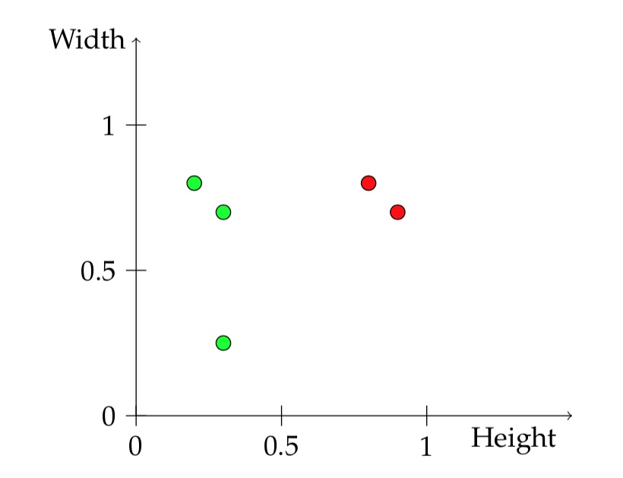
Partitioning the feature space
 | Acidity(A) | Sweetness (S) | y=‘Great taste’?
Bev1 | 0.8 | 0.8 | 1
Bev2 | 0.3 | 0.25 | 0
Bev3 | 0.2 | 0.8 | 0
Bev4 | 0.3 | 0.7 | 0
Bev5 | 0.9 | 0.7 | 1
Lets position Bev1 on this feature space
Sweetness
o/w
S>= 0.75
Predict f(x)=0
Predict f(x)=1
Acidity

Slide 12
Partitioning the feature space
 | Acidity(A) | Sweetness (S) | y=‘Great taste’?
Bev1 | 0.8 | 0.8 | 1
Bev2 | 0.3 | 0.25 | 0
Bev3 | 0.2 | 0.8 | 0
Bev4 | 0.3 | 0.7 | 0
Bev5 | 0.9 | 0.7 | 1
Lets position Bev1 on this feature space
Sweetness
o/w
S>= 0.75
Predict f(x)=0
Predict f(x)=1
Acidity

Slide 13










Partitioning the feature space
 | Acidity(A) | Sweetness (S) | y=‘Great taste’?
Bev1 | 0.8 | 0.8 | 1
Bev2 | 0.3 | 0.25 | 0
Bev3 | 0.2 | 0.8 | 0
Bev4 | 0.3 | 0.7 | 0
Bev5 | 0.9 | 0.7 | 1
S=0.75
Each binary classifier has a decision region:
How it partitions the feature space.
Sweetness
o/w
S>= 0.75
Predict f(x)=0
Predict f(x)=1
Acidity

Slide 14
Binary classification with depth 2 decision tree:
 | Acidity(A) | Sweetness (S) | y=‘Great taste’? | Model 2 predicts
Bev1 | 0.8 | 0.8 | 1 | ?
Bev2 | 0.3 | 0.25 | 0 | ?
Bev3 | 0.2 | 0.8 | 0 | ?
Bev4 | 0.3 | 0.7 | 0 | ?
Bev5 | 0.9 | 0.7 | 1 | ?
Accuracy of this model on the training set is:
?
Model 2:
This model splits first on A with threshold 0.5
and then on S with threshold 0.75.
o/w
A>= 0.5
Predict f(x)=1
o/w
S>0.75
Predict f(x)=0
Predict f(x)=1

Slide 15
Binary classification with depth 2 decision tree:
 | Acidity(A) | Sweetness (S) | y=‘Great taste’? | Model 2 predicts
Bev1 | 0.8 | 0.8 | 1 | 1
Bev2 | 0.3 | 0.25 | 0 | 1
Bev3 | 0.2 | 0.8 | 0 | 1
Bev4 | 0.3 | 0.7 | 0 | 1
Bev5 | 0.9 | 0.7 | 1 | 0
Accuracy of this model on the training set is:
?
Model 2:
This model splits first on A with threshold 0.5
and then on S with threshold 0.75.
Could you do get better training accuracy by labeling leaves differently ?
What is the highest training accuracy you can get?
o/w
A>= 0.5
Predict f(x)=1
o/w
S>0.75
Predict f(x)=0
Predict f(x)=1

Slide 16
Binary classification with depth 2 decision tree:
 | Acidity(A) | Sweetness (S) | y=‘Great taste’? | Model 2 predicts
Bev1 | 0.8 | 0.8 | 1 | 1
Bev2 | 0.3 | 0.25 | 0 | 1
Bev3 | 0.2 | 0.8 | 0 | 1
Bev4 | 0.3 | 0.7 | 0 | 1
Bev5 | 0.9 | 0.7 | 1 | 0
Accuracy of this model on the training set is:
Model 2:
Sweetness
o/w
A>= 0.5
leaf 1
leaf 3
leaf 1
o/w
S>0.75
leaf 2
leaf 2
leaf 3
Acidity

Slide 17
Binary classification with a linear classifier
 | Acidity(A) | Sweetness (S) | y=‘Great taste’? | Model 3 predicts
Bev1 | 0.8 | 0.8 | 1 | ?
Bev2 | 0.3 | 0.25 | 0 | ?
Bev3 | 0.2 | 0.8 | 0 | ?
Bev4 | 0.3 | 0.7 | 0 | ?
Bev5 | 0.9 | 0.7 | 1 | ?
Model 3:
f(A,S) = 1 if A+S -1 ≥ 0
0 otherwise
Sweetness
Compute the predictions of this model.
Draw the decision boundary
Acidity

Slide 18
Binary classification with a linear classifier
 | Acidity(A) | Sweetness (S) | y=‘Great taste’? | Model 3 predicts
Bev1 | 0.8 | 0.8 | 1 | ?
Bev2 | 0.3 | 0.25 | 0 | ?
Bev3 | 0.2 | 0.8 | 0 | ?
Bev4 | 0.3 | 0.7 | 0 | ?
Bev5 | 0.9 | 0.7 | 1 | ?
Model 3:
f(A,S) = 1 if A+S -1 ≥ 0
0 otherwise
Sweetness
Compute the predictions of this model.
Draw the decision boundary
Acidity

Slide 19
Binary classification with a linear classifier
 | Acidity(A) | Sweetness (S) | y=‘Great taste’? | Model 3 predicts
Bev1 | 0.8 | 0.8 | 1 | ?
Bev2 | 0.3 | 0.25 | 0 | ?
Bev3 | 0.2 | 0.8 | 0 | ?
Bev4 | 0.3 | 0.7 | 0 | ?
Bev5 | 0.9 | 0.7 | 1 | ?
Model 4:
f(A,S) = 1 if A+S -1.3 ≥ 0
0 otherwise
Sweetness
Compute the predictions of this model.
Draw the decision boundary
Acidity

Slide 20
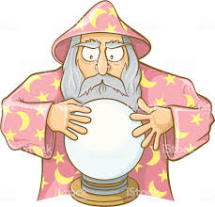
Supervised learning paradigm
Features
(Acidity, Sweetness, Color, Carbonation …)
prediction
Model f
Goal is to design and train the model to make good predictions on data it has not seen.

Slide 21
Breakout session
https://docs.google.com/spreadsheets/d/1_qFR1ftXklTOmCL51wDlH5hGHlNi42qyfeC1ME6lcE8/edit#gid=0
tinyurl.com/3c44byv2
For any training set, we can make a tree of sufficient depth, that has perfect accuracy.
We can create models with perfect accuracy that are useless for prediction.
how?

Slide 22
Training and Test set
 | Acidity(A) | Sweetness (S) | y=‘Great taste’?
Bev1 | 0.8 | 0.8 | 1
Bev2 | 0.3 | 0.25 | 0
Bev3 | 0.2 | 0.8 | 0
Bev4 | 0.3 | 0.7 | 0
Bev5 | 0.9 | 0.7 | 1
 | Acidity(A) | Sweetness (S) | y=‘Great taste’?
Bev6 | 0.7 | 0.7 | ?
Bev7 | 0.1 | 0.1 | ?
… | … | … | ?
… | … | … | ?
… | … | … | ?
The goal of prediction is to predict the future, not the past.
We have a few more beverages with different features and we want to predict if people will like them, without administering a study for each one.
(Could have billions of combinations of features)
How do we build a prediction model that goes from (Acidity, Sweetness)-> will people like it?
How do we evaluate if the model works well. (Model evaluation)
How do we interpret if works well for the right reasons. (Model interpretability)
We will spend a lot of time covering all these topics

Slide 23
Statistical Learning Framework
Assume a distributed D over features. x_{i} ~D.
Assume a true labeling function h_{T}(x)
We can compute the training error, but also define the True Loss aka Generalization Error

Slide 24
Types of supervised learning problems (Tabular data)
Given features about a house predict the sale price. (Square feet, number of bedrooms, bathrooms, Zip Code, HasPool, etc) https://www.kaggle.com/c/house-prices-advanced-regression-techniques
Given income, education, number of credit cards etc, predict if an individual will default on their loan
Instacart Market Basket analysis (Predict which products will an Instacart consumer purchase again) https://www.kaggle.com/c/instacart-market-basket-analysis
Predict sales of Walmart weather sensitive products in 40 locations https://www.kaggle.com/c/walmart-recruiting-sales-in-stormy-weather
Given patient data predict the clinical outcome for a disease.
Predict next year re-hospitalization using hospital data https://www.kaggle.com/c/hhp

Slide 25
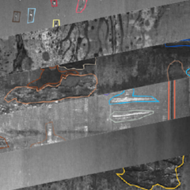
Types of supervised learning problems (Image data / Computer vision)
Given images of manufactured steel predict there will be defects. https://www.kaggle.com/c/severstal-steel-defect-detection
Severstal, a leading steel mining and production company wants to use machine learning to automatically predict if manufactured flat sheets have defects.
Here the features are pixels.

Slide 26
Types of supervised learning problems (Image data / Computer vision)
Given images of manufactured steel predict there will be defects. (Here features are the pixels of the image, plus usually categorical features) https://www.kaggle.com/c/severstal-steel-defect-detection
Dogs vs Cats: Given an image classify if it is an image of a dog or a cat https://www.kaggle.com/c/dogs-vs-cats-redux-kernels-edition
Estimate density of wheat heads from outdoor field images https://www.kaggle.com/c/global-wheat-detection

Slide 27
Types of supervised learning problems (Time series data)
Predict an upcoming seizure using EEG recordings
https://www.kaggle.com/c/seizure-prediction
Covid19 Global forecasting per city https://www.kaggle.com/c/covid19-global-forecasting-week-5/discussion/151461
Speech recognition, Music Genre Classification, Financial time-series forecasting

Slide 28
Types of supervised learning problems (Natural Language processing (NLP))
Twitter sentiment detection
https://www.kaggle.com/c/tweet-sentiment-extraction
(Here the features are the text of the Tweet)
News Article classification (Politics, Sports, Entertainment)
Detecting toxic content in online conversations https://www.kaggle.com/c/quora-insincere-questions-classification

Slide 29
A taxonomy for machine learning
Supervised learning:
I.e. there exists a target variable y we are trying to predict.
Splits to:
Binary classification
Multi-class classification
Regression (y continuous)
Unsupervised learning:
There is no y
Ok what to do ?
Clustering
Association analysis (diapers and beer)
Anomaly detection
Generation of artificial data (create new features that look like natural ones).

Slide 30
Unsupervised problems: Clustering
Clustering.
Consider points in feature space (no labels).
Assign points in clusters, so that all similar points are assigned together.
Frequently used algorithms:
K-means
DBSCAN

Slide 31
Unsupervised problems: Dimensionality Reduction
Dimensionality reduction
Reduce the number of features, to find a lower dimensional representation.
Hopefully represents the important directions in dataset
Frequently used algorithms:
PCA
Sparse PCA, Nonnegative PCA, etc
t-SNE
Deep-learning representation learning

Slide 32
Unsupervised problems: Generative modeling
In supervised the model takes features and predicts labels.
A generative model produces new features.
E.g. Can imagine the attributes of a fictional apartment or a fictional drink , that follow the same statistics as the ones in the data.
Can image pixel values of fictional faces, dogs, landscapes, etc.
https://www.thispersondoesnotexist.com/
https://thiscatdoesnotexist.com/
https://github.com/paubric/thisrepositorydoesnotexist (Cats, Rentals, Poems, etc).
Can generate audio or time series
https://jukebox.openai.com/?song=799583581
Can generate language
https://transformer.huggingface.co/

Slide 33
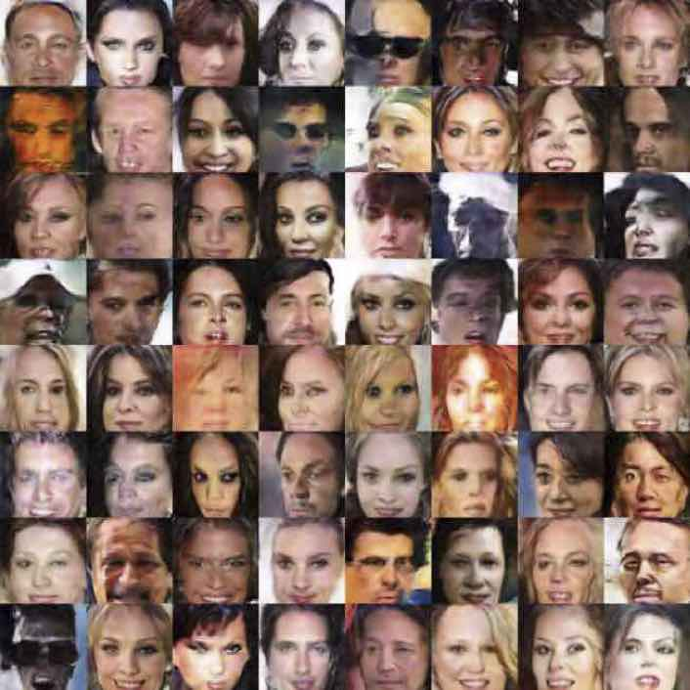
Unsupervised problems: Generative modeling
Generating images
Generative modeling is used for solving inverse problems.
Denoising, Missing data, changing attributes, outlier detection, etc

Slide 34
Breakout Session
Propose one supervised and one unsupervised learning problem from your work.
What would the features and the label be.
How would you collect data.
How would you evaluate a predicting model.

Slide 36
AI/ML: History and success stories.
1955: John McCarthy, Marvin Minsky, Nathaniel Rochester and Claude Shannon propose to do a 2 month, 10 person workshop to study artificial intelligence in Dartmouth college.
``We think a significant advance can be made if a carefully selected group of scientists work on it for a summer’’.
We would like to enable a machine to do what a man does when they say they are thinking.
The term artificial intelligence is first introduced. This was in contrast to cybernetics which researchers like Norbert Wigner from MIT were advocating.
Notes:
https://www.digitaltrends.com/cool-tech/history-of-ai-milestones/

Slide 37
AI: History and success stories.
`The Golden years’ 1956-1974.
1968: ”By the year 2001 we will have machines with the intelligence that matched or exceeded humans”. Arthur Clarke and Stanley Kubrik.
1970: Marvin Minsky: From 3-8 years we will have a machine with the general intelligence of a human being’.
Theseus: Mechanical mouse that learns to solve a maze.
``Reasoning as search.’’
Weizenbaum’s ELIZA AI Conversation system.
DARPA 2.2 Million AI grant to MIT (Minsky, McCarthy). Stanford AI project etc..
Notes:
https://www.digitaltrends.com/cool-tech/history-of-ai-milestones/

Slide 38
AI: History and success stories.
Translate the biblical saying:
`` The spirit is willing but the flesh is weak’’
into Russian and then back to English
to get :
``The vodka is strong but the steak is rotten’’.
First AI winter: 1974-1980.
Minsky and Papert publish: ``Perceptrons”.
"Virtually nothing is known about the computational capabilities of this latter kind of machine. We believe that it can do little more than can a low order perceptron."
Notes:
https://www.digitaltrends.com/cool-tech/history-of-ai-milestones/

Slide 39
AI: History: 1980-1988: second boom and bust
Expert systems. Logical rule based systems created by rules obtained from experts.
1980: expert system XCON saves 40 million dollars annually for DEC.
Knowledge-based systems.
Russell & Norvig 2003, p. 24: "Overall, the AI industry boomed from a few million dollars in 1980 to billions of dollars in 1988.” Soon after that came the second AI Winter (1987-1993).
Notes:
https://www.digitaltrends.com/cool-tech/history-of-ai-milestones/

Slide 40
AI: History: Modern times
Expert systems. Logical rule based systems created by rules obtained from experts.
1980: expert system XCON saves 40 million dollars annually for DEC.
Knowledge-based systems.
Russell & Norvig 2003, p. 24: "Overall, the AI industry boomed from a few million dollars in 1980 to billions of dollars in 1988.” Soon after that came the second AI Winter (1987-1993).
Notes:
https://www.digitaltrends.com/cool-tech/history-of-ai-milestones/

Slide 41
AI: History: Modern times
DeepBlue vs Kasparov 1997 ,
Watson Jeopardy, 2011.
Deepmind beats Go world champion, 2016,
Vision: 2012, Hinton, Sutskever, Krizhevsky submit a CNN for the Imagenet challenge. AlexNet shockingly outperforms previous models.
Real-Time Translation, Speech recognition: Smart speakers …
ML used by Google and Facebook advertising, Search, Maps
Amazon warehouses (Fulfillment centers)
Notes:
https://www.digitaltrends.com/cool-tech/history-of-ai-milestones/

